Slide 1
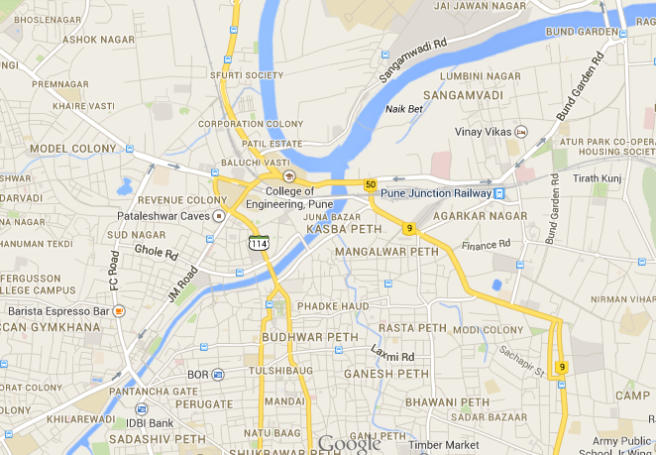


Intelligent Public Transport Management System
Guided by: Prof. S N Shilaskar
Aniket Shirsat Harshal Sarda Shantanu Hadgekar

Slide 2
Introduction
Public transit bus offers an invaluable service to the everyday commuter. Millions of people in every major metro area rely on public transport for daily travel.
This system should run smoothly and reliably as there will be total chaos if it were to break down.
We propose a method to make the public transportation system more efficient and flexible.
Our system makes it possible to track each bus individually in real time.

Slide 3
Special modules are placed in buses and the bus stands which help us in tracking the buses.
This information is then made available to the commuters via the Internet.
The information contains the location of the buses, the ETAs (estimated time of arrival) for the next stops, etc.

Slide 4
London iBus System
The iBus system can locate every bus to an accuracy of about ten metres, or its distance from the nearest stop by around ten seconds. It does this using several instruments like Global Positioning System (GPS), Odometers, Speedometers, etc.
The system mainly relies on the GPS data which is used to roughly determine the location.
This data is then transmitted to the Central system via GPRS.
The Central System then makes a “best guess” of the bus position and depicts the overall image derived from the data provided by all buses.

Slide 5
Rail Radar
A train tracking system has been developed by the Indian Railways.
Every passenger train running in the country can be seen on a map of India in real time

Slide 6
RaspberryPi
The RaspberryPi is a credit card sized single board computer developed in the UK by the RaspberryPi foundation.
It has a Broadcom BCM2835 system on a chip which includes an ARM1176ZF-S 700 MHz processor, VideoCore IV GPU, and has 512 MB of RAM and uses SD card for booting and long term storage.
Debian and Arch Linux Arm distributions provided by foundation for download.
Has support for displays and higher level peripherals like Ethernet and USB. Also features low level peripherals like General Purpose Input Output and UART.

Slide 7
Specifications
CPU: 700 MHz ARM11 ARM1176JZF-S core
GPU: Broadcom VideoCore IV, OpenGL ES 2.0, OpenVG 1080p30 H.264 high-profile encode/decode
Memory:(SDRAM) 512MB
USB 2.0 ports: 2
Onboard Storage: Secure Digital SD / MMC / SDIO card slot
Power ratings: 700 mA, (3.5 W)
Power source: 5 V (DC) via Micro USB type B or GPIO header

Slide 8
Python
Widely used general-purpose, high-level programming language.
Python is free to use, even for commercial products, because of its OSI-approved open source license.
Modules to interface General Purpose Input Output pins, UART communication and two-wire communication on RasberryPi are provided by the Raspberry Pi Foundation.

Slide 9
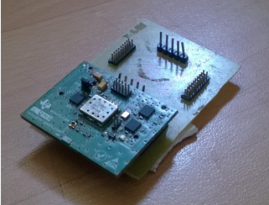
Global Positioning System (GPS)
SimpleLink GPS CC4000 Module by GNS has a GPS driver and firmware fully integrated into the Module.
Supports industry standard NMEA 0183 interface protocol communication.

Slide 10
GPS Interfacing: Hardware
5 pins for interfacing.
VCC and GROUND used to provide supply of 3.3V regulated to the module.
Push-to-fix is an input pin for the module which is pulled high to enable GPS tracking
TX pin transmits GPS data in NMEA protocol in UART host protocol at 9600 baud rate.

Slide 11
GPS Interfacing: Software
NMEA 0183 is a combined electrical and data specification for communication between marine electronics defined by and controlled by the National Marine Electronics Association.
GGA: Time, Position and Fix Type Data
GSA: Latitude, Longitude, UTC Time of Position Fix and Status GPS Receiver Operating Mode, Satellites Used in the Position Solution, and DOP Values
GSV: Number of GPS Satellites in View, Satellite ID Numbers, Elevation, Azimuth, and SNR Values
VTG: Course and Speed Information Relative to the Ground
RMC: Recommended Minimum Specific GPS Data

Slide 12
Zigbee
Specification for a suite of high level communication protocols used to create personal area networks built from small, low power digital radios.
Based on the IEEE 802.15.4 standard.
Used in applications that require only low data rate, long battery life, and secure networking.
Has a defined rate of 250 kbit/s.
Suited for this project because of its low power consumption and high reliability.

Slide 13
Interfacing ZigBee
ZigBee modules have the ability to transmit Digital, PWM, Analog or Serial RS232 signals wirelessly.
3 signals needed to communicate via UART. These are RXD (receive), TXD (transmit), GND (common ground).
16 direct sequence channels available.
ZigBee modules configured with the same serial settings i.e. baud rate, channel, data bits can communicate with each other.

Slide 14
Texas Instruments LaunchPad
A 16-bit microcontroller from Texas Instruments MSP430 Series. It has 16KB flash, 512 bytes RAM, up to 16-MHz CPU speed, 10-bit ADC.
USB debugging and programming interface featuring a driverless installation and application UART serial communication with up to 9600 baud rate.
Two general-purpose digital I/O pins connected to green and red LEDs for visual feedback.
Two push button for user feedback and device reset.
High-quality 20-pin DIP socket for an easy plug-in or removal of the target device.

Slide 15
In Vehicle Module
Gets the current GPS coordinates to get real time location details of the bus.
Continuously checks for ZigBee signals to update the last bus stop details.
Posts this information on the Internet in such a way so that it can be accessed by all other commuters.
Displays the consolidated information on the accompanying display unit for the travellers inside to know about upcoming stops.

Slide 16
GPS CC4000 module
UART communication
3.3 V
Raspberry
Pi
Information Consolidation
USB to Serial converter
Through mySQL commands
Display
Zigbee Rx
Internet
12 V
Wireless Zigbee Signals

Slide 17
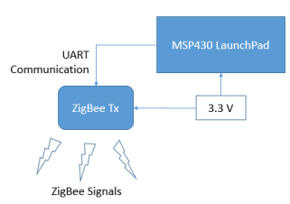
Bus Stand Module
Module installed on every bus stand.
Continuously transmits the unique identification number of the bus-stand at an interval of 5 seconds.

Slide 18
When the vehicle reaches the proximity of the bus-stand, it receives the uniqueID and searches it in the pre-installed dataset.
Format of the uniqueID is defined as ‘BUS-STAND0xxxxx’. Here x can be a value between 0 and 9.
Starting point is given a uniqueID which is a multiple of 100.
Consecutive bus stands are given uniqueID’s in an incremental fashion.

Slide 19
MySQL
Open-source relational database management system.
Popular choice of database for use in web applications.
Initially the MySQL database is hosted on a web server. A lot of free web hosting sites are available which support mysql and we have chosen one for our project. This MySQL is continuously updated by the python script sending all the relevant information. Its all properly maintained and categorized by MySQL

Slide 20
PHP
Server-side scripting language designed for web development but also used as a general purpose programming language.
Usually executed within the address space of a web server with a PHP interpreter embedded as a module.
The Google maps is written in JavaScript and it cannot directly interface with the MySQL. That is why we use PHP. Using some native PHP functions we open the connection to this remote database and run a appropriate query which fetches the data from the database and converts in into XML format which can be read by JavaScript.

Slide 21
AJAX
Used on the client-side to create asynchronous Web applications.
Web applications can send data to, and retrieve data from, a server asynchronously (in the background) without interfering with the display and behaviour of the existing page.
Ajax is used to make our system asynchronously read the database. Without using AJAX we would have had to refresh the complete page for every single change in marker location which is obviously unfavourable. AJAX keeps checking for bus data and updates only the marker pointer so that only that point can change and the background maps canvas remains constant.

Slide 22
JavaScript
Used as part of web browsers, whose implementations allow client-side scripts to interact with the user, control the browser, and alter the document content that is displayed.
JavaScript is used to use the Maps API. Here our main front end code runs which updates the marker position at required intervals.

Slide 23
Google Maps API
Google launched the Google Maps API to allow developers to integrate Google Maps into their websites.
Free service and is available to anyone who wishes to use Google Maps in their application.
API is based on JavaScript.
Using the Maps API, the real time target moving animation can be shown using an appropriate marker.

Slide 24
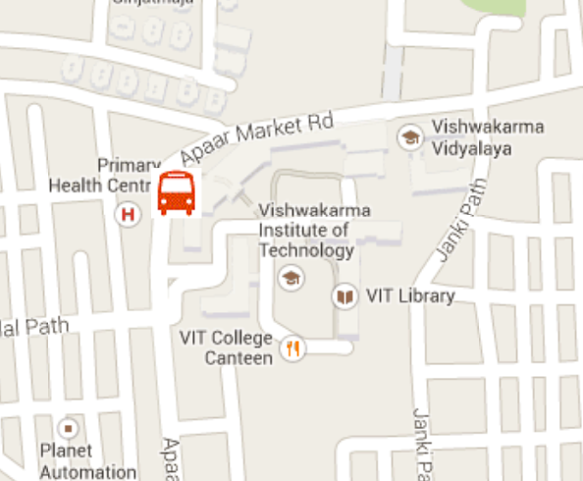
Sample results

Slide 25
Front End User
Maps API
Target Filtering and ETA calculation
User Device
Request for Bus Info
Bus-Stop Crossed
Ajax call to PHP to mySQL
InVehicle Module
Bus-Stand module
Bus Tracking Info
Internet
InVehicle Display

Slide 26
Conclusion
Basic Vehicle Tracking system was developed using GPS and Zigbee.
The proposed system combines positioning hardware, and a communications platform that can be used to monitor and track a public transport in real time.
This enables the transport management centres to observe, collect and analyze location information about the vehicle in real time.
The benefits to the passengers mean better on time performance and less waiting time at bus stops.

Slide 27
Future Scope
Combination of all the separate modules to have a one single board which includes RaspberryPi, GPS and GSM.
Reduces the cost and also miniaturizes the whole system.
ETA calculation can be refined by considering the time taken by the last buses that travelled along the same route.

Slide 28
Thank you

